Slide 1

BEM & SMACSS
“SMACSS is becoming one of the most useful contributions to front-end discussions in years” - Paul Smith
BEM (Block Element Modifier) is a popular CSS class naming convention that makes CSS easier to maintain.

Slide 2
SMACSS
Smacss
SMACSS (pronounced “smacks”) is more style guide than rigid
framework. There is no library within here for you to download or
install. SMACSS is a way to examine your design process and as a
way to fit those rigid frameworks into a flexible thought process. It
is an attempt to document a consistent approach to site development
when using CSS.

Slide 3
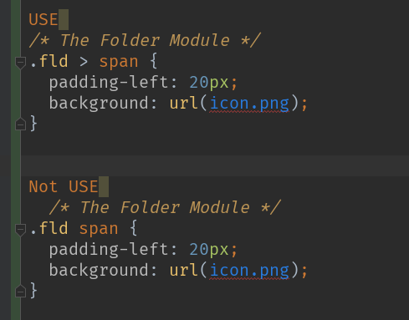
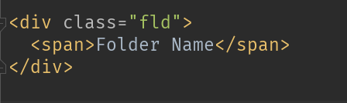
SMACSS
Avoid element selectors
Use child or descendant selectors with element selectors if the element
selectors will and can be predictable. Using .module span is
great if a span will predictably be used and styled the same way
every time while within that module.
Example:

Slide 4
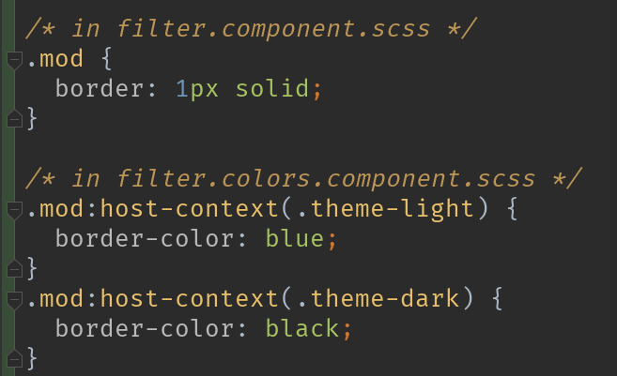
SMACSS
separate scss files for colors, fonts and architect
Very helpful when you building big enterprise app with a lots of functionality like color themes control and fonts change in the settings of our app
:host-context()
Sometimes it's useful to apply styles based on some condition outside of a component's view. For example, a CSS theme class could be applied to the document <body> element, and you want to change how your component looks based on that.
Use the :host-context() pseudo-class selector, which works just like the function form of :host(). The :host-context() selector looks for a CSS class in any ancestor of the component host element, up to the document root. The :host-context() selector is useful when combined with another selector.
The following example applies a background-color style to all <h2> elements inside the component, only if some ancestor element has the CSS class theme-light.

Slide 5
BEM
Block
Encapsulates a standalone entity that is meaningful on its own. While blocks can be nested and interact with each other, semantically they remain equal; there is no precedence or hierarchy. Holistic entities without DOM representation (such as controllers or models) can be blocks as well.
Element
Parts of a block and have no standalone meaning. Any element is semantically tied to its block.
Modifier
Flags on blocks or elements. Use them to change appearance, behavior or state.

Slide 6
BEM
Block
Naming
Block names may consist of Latin letters, digits, and dashes. To form a CSS class, add a short prefix for namespacing: .block
HTML
Any DOM node can be a block if it accepts a class name.
<div class="block">...</div>
CSS
Use class name selector only
No tag name or ids
No dependency on other blocks/elements on a page
.block { color: #042; }

Slide 7
BEM
Element
Naming
Element names may consist of Latin letters, digits, dashes and underscores. CSS class is formed as block name plus two underscores plus element name: .block__elem
HTML
Any DOM node within a block can be an element. Within a given block, all elements are semantically equal.
<div class="block">
...
<span class="block__elem"></span>
</div>
CSS
Use class name selector only
No tag name or ids
No dependency on other blocks/elements on a page
Good
.block__elem { color: #042; }
Bad
.block .block__elem { color: #042; }
div.block__elem { color: #042; }

Slide 8
BEM
Modifier
Naming
Modifier names may consist of Latin letters, digits, dashes and underscores. CSS class is formed as block’s or element’s name plus two dashes: .block--mod or .block__elem--mod and .block--color-black with .block--color-red. Spaces in complicated modifiers are replaced by dash.
HTML
Modifier is an extra class name which you add to a block/element DOM node. Add modifier classes only to blocks/elements they modify, and keep the original class:
Good
<div class="block block--mod">...</div>
<div class="block block--size-big
block--shadow-yes">...</div>
Bad
<div class="block--mod">...</div>
CSS
Use modifier class name as selector:
.block--hidden { }
To alter elements based on a block-level modifier:
.block--mod .block__elem { }
Element modifier:
.block__elem--mod { }

Slide 9
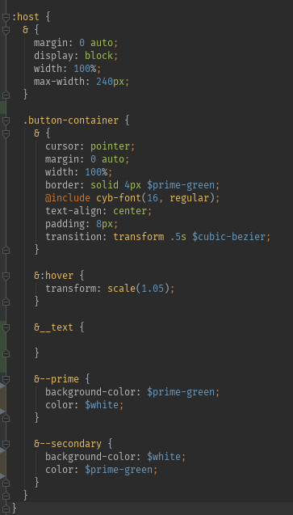
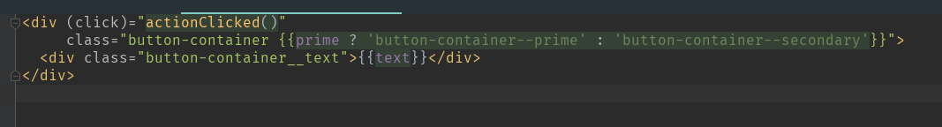
BEM
Example :

Slide 10
BEM
pros and cons
Better HTML/CSS decoupling
By avoiding use of HTML element names in CSS selectors, BEM makes CSS code readily portable to a different HTML structure.
Better CSS performance
Browsers evaluate CSS selectors right to left and BEM encourages frontend developers to create a flat CSS structure with no nested selectors. So the less browsers have to evaluate, the faster they can render.
No CSS conflicts
BEM avoids CSS conflicts by using unique contextual class names for every block, element and modifier combination.
Ease of code maintenance
BEM's modular approach encourages developing independent modules of code and hence easier to maintain & update without affecting other modules in the project.
File size bloating
It is known that BEM can bloat file sizes with the longer CSS class names, but this can easily be overcome by minifying and gzipping production code.
Ugly HTML code
While the overall HTML code does 'look' ugly with BEM class names, the visitor of the website or application will not look in the source too often, so it is not really an issue.

